Slide 1
How Well Computers Can Read Spatial Patterns using Visual Symbols in Choropleth Maps Compared with Humans
Survey Experiment Instruction (Tentative)

Slide 2
Introduction: What's included here
Slides included here represent an overview of the survey.
Each experiment contains five sections:
Informed consent form
Survey experiment instruction
Background information
Questions for maps
Completion code
We will introduce the contents in background information, questions for maps, and completion code in the slides.

Slide 3
Background information
The participants will be asked about their background in geography and cartography, which will be used for experiment control purposes.
There are three questions in this section:
Have you taken a class in Department of Geography?
Have you taken a cartography related class?
Is this survey your class assignment from either GeoVisualization (GEOG 5201) or Design and Implementation of GIS (GEOG 5223)?

Slide 4
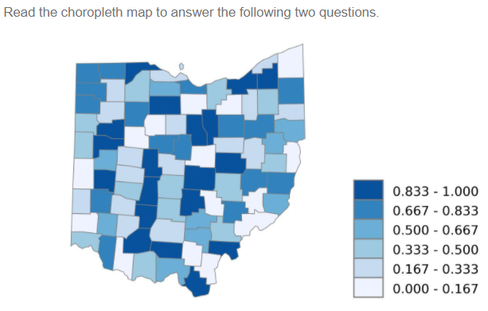
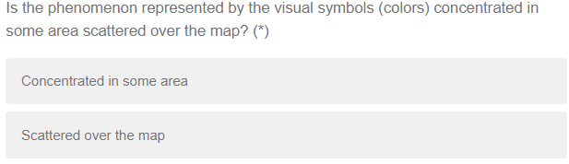
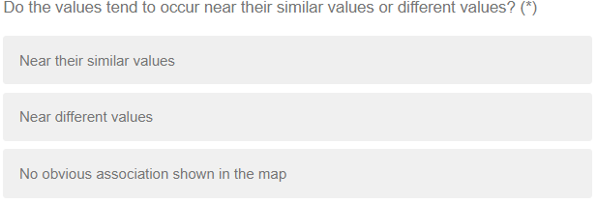
Questions for maps
Participants will be presented two questions for one map in one page.
There are totally 16 maps and 32 questions in 16 pages.
Participants must answer the two questions for one map before continuing to the next page with the next map and questions.
Notes:
Five map examples

Slide 5

Completion code
If the participant is a student in the geography classes, GEOG 5201 or GEOG 5223, there will be a completion code generated randomly at last.
The completion code will be copied and submited in his or her Carmen system, serving as the proof of completion of extra homework.

